Slide 1
COMP3028 Software Architecture
Architecture modelling and representation: Architectural structures and views
Notes:
体系结构和视图

Slide 2
Which Structures are Architectural?
A structure is architectural if it supports reasoning about the system and the system’s properties.
The reasoning should be about an attribute of the system that is important to some stakeholder.
These include
functionality achieved by the system
the availability of the system in the face of faults
the difficulty of making specific changes to the system
the responsiveness of the system to user requests,
many others
…

Slide 3
Stakeholder
Earlier, we already gave some examples of stakeholders,
Today let’s have a look how the ISO/IEC/IEEE 42010:2022 standard defines stakeholders.
To fully understand this definition, we need to read other definitions in this standard (etc.)

Slide 4
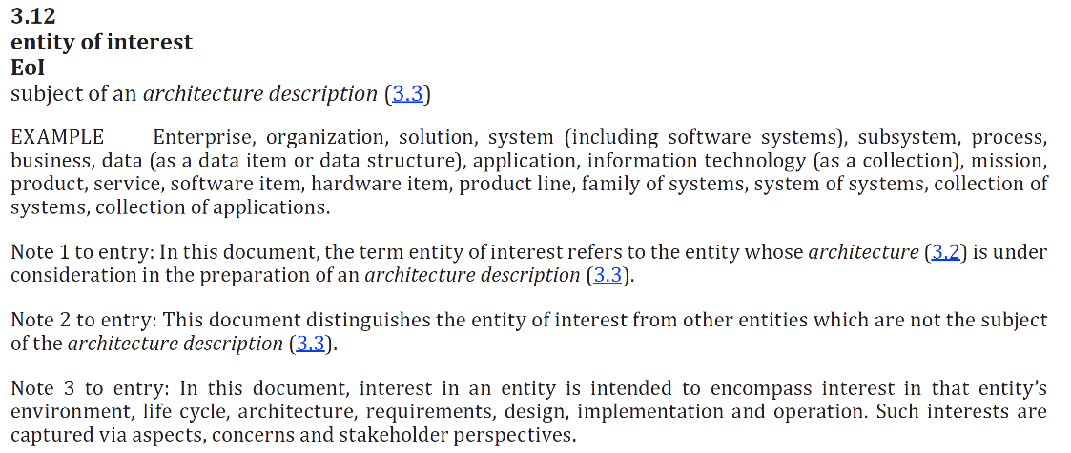

Slide 5
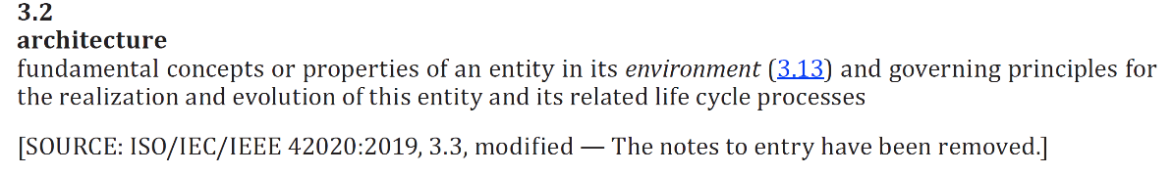

Slide 6
Stakeholder perspectives
Stakeholder perspectives are ways of thinking about the software in a context, especially as they relate to concerns.
There are often multiple stakeholder perspectives on any software system.
EXAMPLE – a mobile app may have the following perspectives
Development perspective
Deployment perspective
Customization perspective
Each perspective results in one or more concerns.

Slide 7
Stakeholder concerns
Concerns are matters of interest or importance to one or more stakeholders
A concern can be shared by one or more stakeholders
A stakeholder can hold more than one concern
During the software life cycle, concerns can arise at any time including (but not limited to) during conceptualization, when design choices are made, from construction or implementation, through deployment, operation, transfer of ownership, retirement and disposal.

Slide 8
Concerns examples
How is the system maintained?
What system behaviours are safety-critical?
What is the cost to operate?
In case of a flight navigation system of a commercial aircraft, what is GPS signal availability, tracking, degree of accuracy, line of sight reception, altitude or elevations?
What is the system’s ability to maintain confidentiality, integrity, and availability for protecting operations?
What is the ability to support a seamless transition from a legacy capability to a modernized operational capability?

Slide 9
Module Structures
Some structures partition systems into implementation units, which we call modules.
Modules are assigned specific computational responsibilities, and are the basis of work assignments for programming teams.
In large projects, these elements (modules) are subdivided for assignment to sub-teams.

Slide 10
Component-and-connector Structures
Other structures focus on the way the elements interact with each other at runtime to carry out the system’s functions.
We call runtime structures component-and-connector (C&C) structures.
In our use, a component is always a runtime entity.
In SOA, the system is to be built as a set of services.
These services are made up of (compiled from) the programs in the various implementation units – modules.

Slide 11
Allocation Structures
Allocation structures describe the mapping from software structures to the system’s environments
For example
Modules are assigned to teams to develop, and assigned to places in a file structure for implementation, integration, and testing.
Components are deployed onto hardware in order to execute.

Slide 12

Multiple Choice(single)
Points: 1
Programming team developing our cafeteria system wants to know what units of implementation will be assigned with functional responsibilities. Which structures can help reason about that?
A
Module structures
B
Component and connector structures
C
Allocation structures
Submit

Slide 13
Structures Provide Insight
Each structure provides a perspective for reasoning about some of the relevant quality attributes.
For example:
The module structure, which embodies what modules use what other modules, is strongly tied to the ease with which a system can be extended.
The concurrency structure (belongs to the component-connector category), which embodies parallelism within the system, is strongly tied to the ease with which a system can be made free of deadlock and performance bottlenecks.
The deployment structure (belongs to the allocation category) is strongly tied to the achievement of performance, availability, and security goals.

Slide 14
We know understand that the structures can in fact help us to reason about different attributes of the system that has not been developed yet
In the next section, we will see more examples:
the different categories of architectural structures
and how they help us to reason about the system

Slide 15
We introduced these 3 categories of structures
Module
Component-connector
Allocation
Let’s first have a quick look to see what kind of questions about the system can structures from each category help us answer.

Slide 16
Module Structures
Module structures embody decisions as to how the system is to be structured as a set of code or data units
In any module structure, the elements are modules of some kind (perhaps classes, or layers, or merely divisions of functionality, all of which are units of implementation).
Modules are assigned areas of functional responsibility.

Slide 17
Component-and-connector Structures
Component-and-connector structures embody decisions as to how the system is to be structured as a set of elements that have runtime behavior (components) and interactions (connectors).
Elements are runtime components such as services, peers, clients, servers, or many other types of runtime element)
Connectors are the communication vehicles among components, such as call-return, process synchronization operators, pipes, or others.

Slide 18
Component-and-connector Structures
Component-and-connector views help us answer questions such as these:
What are the major executing components and how do they interact at runtime?
What are the major shared data stores?
Which parts of the system are replicated?
How does data progress through the system?
What parts of the system can run in parallel?

Slide 19
Allocation structures
Allocation structures show the relationship between the software elements and elements in one or more external environments in which the software is created and executed.
Allocation views help us answer questions such as these:
What processor does each software element execute on?
In what directories or files is each element stored during development, testing, and system building?
What is the assignment of each software element to development teams?

Slide 20
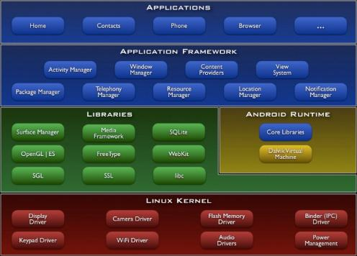
Multiple Choice(multiple)
Points: 1
Which kind of structure is represented in this figure?
A
Module structure
B
Component and connector structure
C
Allocation structure
Submit

Slide 21
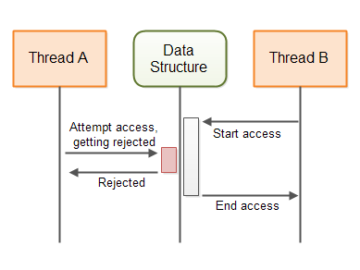
Multiple Choice(multiple)
Points: 1
Which kind of structure is represented in this figure?
A
Module structure
B
Component and connector structure
C
Allocation structure
Submit

Slide 22
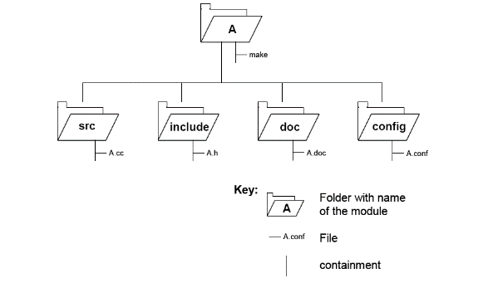
Multiple Choice(multiple)
Points: 1
Which kind of structure is represented in this figure?
A
Module structure
B
Component and connector structure
C
Allocation structure
Submit

Slide 23
We have seen some examples of structures
We will now look at more useful structures from each category
Each of them can provide us with different insights about the system – can help us reason about different aspects of the system

Slide 24
Some Useful Module Structures
Decomposition structure
The units are modules that are related to each other by the is-a-submodule-of relation.
It shows how modules are decomposed into smaller modules recursively until the modules are small enough to be easily understood.
Modules often have products (such as interface specifications, code, test plans, etc.) associated with them.
What does this structure help us to reason about?
The decomposition structure determines, to a large degree, the system’s modifiability, by assuring that likely changes are localized.

Slide 25
Some Useful Module Structures
Uses structure
The units here are also modules, perhaps classes.
The units are related by the uses relation, a specialized form of dependency.
A unit of software uses another if the correctness of the first requires the presence of a correctly functioning version (as opposed to a stub) of the second.
What does this structure help us to reason about?
The ability to easily create a subset of a system allows for incremental development.

Slide 26

Some Useful Module Structures
Layer structure
The modules in this structure are called layers.
A layer is an abstract “virtual machine” that provides a cohesive set of services through a managed interface.
Layers are allowed to use other layers in a strictly managed fashion.
In strictly layered systems, a layer is only allowed to use a single other layer.
What does this structure help us to reason about?
This structure imbues a system with portability, the ability to change the underlying computing platform.

Slide 27
Some Useful Module Structures
Class (or generalization) structure
The module units in this structure are called classes.
The relation is inherits from or is an instance of.
Inheritance is a mechanism for code reuse and to allow independent extensions of the original software
What does this structure help us to reason about?
The class structure allows one to reason about reuse and the incremental addition of functionality.

Slide 28
Some Useful C&C Structures
Service structure
The units are services that interoperate with each other by service coordination mechanisms such as SOAP
The service structure helps to engineer a system composed of components that may have been developed anonymously and independently of each other.
Notes:
Example of web service: soap, xml and json

Slide 29
Some Useful C&C Structures
Concurrency structure
This structure helps determine opportunities for parallelism and the locations where resource contention may occur.
The units are components
The connectors are their communication mechanisms.
The components are arranged into logical threads.

Slide 30
Some Useful Allocation Structures
Deployment structure
The deployment structure shows how software is assigned to hardware processing and communication elements.
The elements are software elements (usually a process from a C&C view), hardware entities (processors), and communication pathways.
Relations are allocated-to, showing on which physical units the software elements reside, and migrates-to if the allocation is dynamic.
This structure can be used to reason about performance, data integrity, security, and availability.
It is of particular interest in distributed and parallel systems.

Slide 31
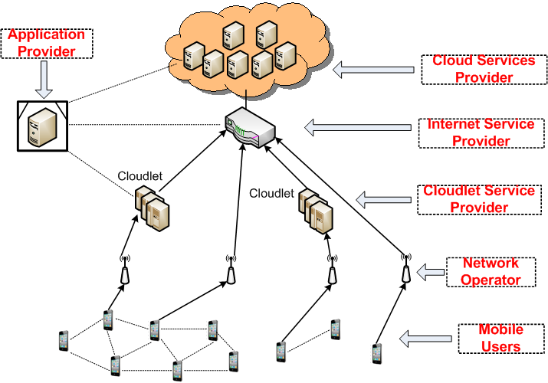
Task allocation in mobile cloud

Slide 32
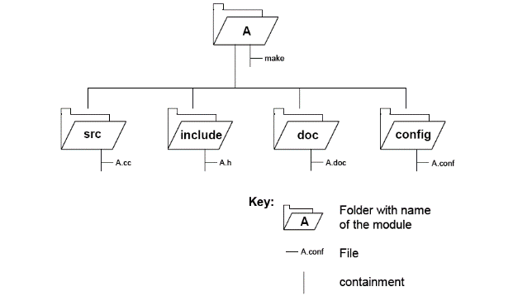
Some Useful Allocation Structures
Implementation structure
This structure shows how software elements (usually modules) are mapped to the file structure(s) in the system’s development, integration, or configuration control environments.

Slide 33
Some Useful Allocation Structures
Work assignment structure
This structure assigns responsibility for implementing and integrating the modules to the teams who will carry it out.

Slide 34
What can be reasoned from structures

Slide 35
Relating Structures to Each Other
Elements of one structure will be related to elements of other structures, and we need to reason about these relations.
A module in a decomposition structure may be manifested as one, part of one, or several components in one of the component-and-connector structures.
In general, mappings between structures are many to many.

Slide 36
Example: Modules vs. Components

Slide 37
Open Question
Points: 10
Why do we need both views of this system?
Tip: what different things can we reason from each of the views?
Open Question is only supported on Version 2.0 or newer.
Answer

Slide 38
Documenting views

Slide 39
Architecture Documentation
Even the best architecture will be useless if the people who need it
do not know what it is;
cannot understand it well enough to use, build, or modify it;
misunderstand it and apply it incorrectly.
All of the effort, analysis, hard work, and insightful design on the part of the architecture team will have been wasted.

Slide 40
Three Uses for Architecture Documentation
1. Education - Introducing people to the system
Introducing people to the system
New members of the team
External analysts or evaluatorsNew architect
2. Primary vehicle for communication among stakeholders
Especially architect to developers
Especially architect to future architect!
3. Basis for system analysis and construction
Architecture tells implementers what to implement.
Each module has interfaces that must be provided and uses interfaces from other modules.
Documentation can serve as a receptacle for registering and communicating unresolved issues.
Architecture documentation serves as the basis for architecture evaluation.

Slide 41
Structures and Views
A structure is the set of elements itself, as they exist in software or hardware
A view is a representation of a coherent set of architectural elements, as written by and read by system stakeholders
In short, a view is a representation of a structure.
For example, a module structure is the set of the system’s modules and their organization.
A module view is the representation of that structure, documented according to a template in a chosen notation, and used by some system stakeholders.
Architects
design structures
document views of those structures

Slide 42
Notations
What forms of expressions do we use in architecture descriptions?
Informal notations
Formal notations
Semiformal notations

Slide 43
Informal notations
Views are depicted (often graphically) using general-purpose diagramming and editing tools
Box-and-line informal drawings annotated with such things as
the nature of the component
Properties
semantics of connections
overall system behavior
The semantics of the description are characterized in natural language

Slide 44
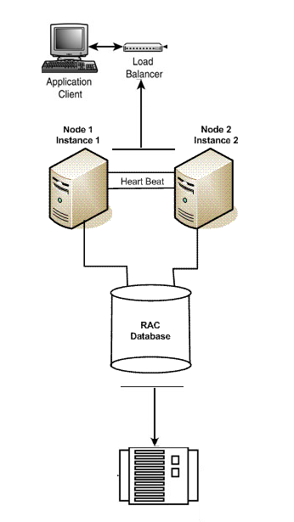
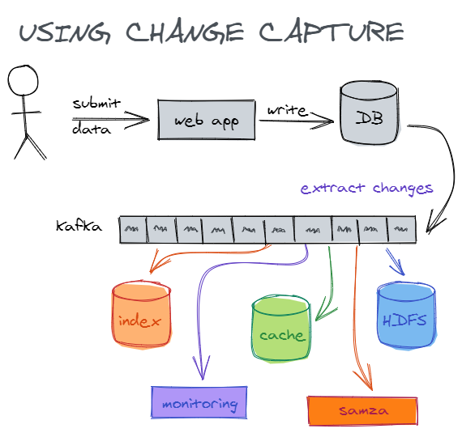
Informal notation example

Slide 45
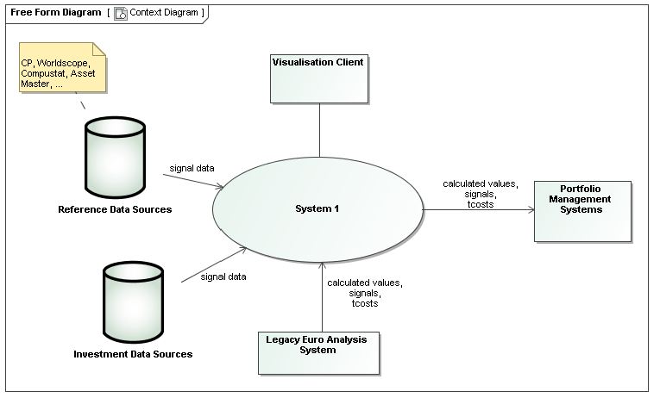
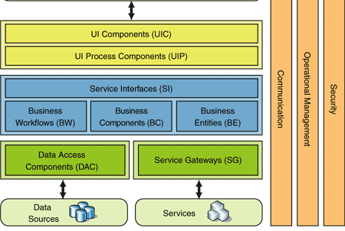
Informal notation example

Slide 46
Informal notations benefits
For a long time have been the most predominant means for describing software architectures
Informal notations drawbacks
The meaning is imprecise - their usefulness is limited
They cannot be formally analyzed
it may be impossible to analyze an architecture for consistency or determine non-trivial properties of it
there is no way to check that a system implementation is faithful to its architectural design
A more rigorous way for describing software architectures is required

Slide 47
Formal notations
Views are described in a notation that has a precise (usually mathematically based) semantics
Many formal architecture description languages (ADLs) have been proposed by research
Different conceptual architectural elements
Different syntax or semantics
Focusing on a specific operational domain
Only suitable for a specific analysis techniques

Slide 48
Formal notations benefits
Formal analysis of both syntax and semantics is possible
Support automation through associated tools
A standard notation for representing architectures helps promote
mutual communication
the embodiment of early design decisions
the creation of a transferable abstraction of a system
Formal notations drawbacks
Formal ADLs have been rarely integrated in the software life-cycle
They are seldom supported by mature tools
Focusing on very specific needs
Lack of industry adoption

Slide 49
Semiformal notations
A way to overcome some of the limitations of informal and formal approaches
Standardized notation that prescribes graphical elements and rules of construction
Lacks a complete semantic treatment of the meaning of those elements
Rudimentary analysis can be applied

Slide 50
UML
UML is a semiformal notation in this sense
The Unified Modeling Language (UML) - a general-purpose, developmental modeling language in the field of software engineering that is intended to provide a standard way to visualize the design of a system
Has been embraced by the industry

Slide 51
UML example

Slide 52
Choosing a Notation
Tradeoffs
Typically, more formal notations take more time and effort to create and understand, but offer reduced ambiguity and more opportunities for analysis.
Conversely, more informal notations are easier to create, but they provide fewer guarantees.
Different notations are better (or worse) for expressing different kinds of information.
UML class diagram will not help you reason about schedulability, nor will a sequence chart tell you very much about the system’s likelihood of being delivered on time.
Choose your notations and representation languages knowing the important issues you need to capture and reason about.

Slide 53
Views
Principle of architecture documentation:
Documenting an architecture is a matter of documenting the relevant views and then adding documentation that applies to more than one view.

Slide 54
Overview of Module Views
Elements
Modules, which are implementation units of software that provide a coherent set of responsibilities.
Relations
Is part of, which defines a part/whole relationship between the submodule—the part—and the aggregate module—the whole.
Depends on, which defines a dependency relationship between two modules. Specific module views elaborate what dependency is meant.
Is a, which defines a generalization/specialization relationship between a more specific module—the child—and a more general module—the parent.
Constraints
Different module views may impose specific topological constraints, such as limitations on the visibility between modules.
Usage
Blueprint for construction of the code
Change-impact analysis
Planning incremental development
Requirements traceability analysis
Communicating the functionality of a system and the structure of its code base
Supporting the definition of work assignments, implementation schedules, and budget information
Showing the structure of information that the system needs to manage
It is unlikely that the documentation of any software architecture can be complete without at least one module view.

Slide 55
Module views notations
Informal:
box-and-line drawings (Nesting can represent “is part of” relations)
tables or lists (indenting can represent “is part of”)
Semi-formal:
UML class diagrams and package diagrams

Slide 56
Overview of C&C Views
Elements
Components. Principal processing units and data stores. A component has a set of ports through which it interacts with other components (via connectors).
Connectors. Pathways of interaction between components. Connectors have a set of roles (interfaces) that indicate how components may use a connector in interactions.
Relations
Attachments. Component ports are associated with connector roles to yield a graph of components and connectors.
Interface delegation. In some situations component ports are associated with one or more ports in an “internal” subarchitecture. The case is similar for the roles of a connector.
Constraints
Components can only be attached to connectors, not directly to other components.
Connectors can only be attached to components, not directly to other connectors.
Attachments can only be made between compatible ports and roles.
Interface delegation can only be defined between two compatible ports (or two compatible roles).
Connectors cannot appear in isolation; a connector must be attached to a component.
Usage
Show how the system works.
Guide development by specifying structure and behavior of runtime elements.
Help reason about runtime system quality attributes, such as performance and availability.
Notes:
Attachments 连接件
Interface delegation 接口委派

Slide 57
Notations for C&C Views
UML components are good match for C&C components.
Notes:
组件 + 接口（Components），然后连线（Connectors）

Slide 58
Notations for C&C Views
UML connectors are not rich enough to represent many C&C connectors.
UML connectors cannot have substructure, attributes, or behavioral descriptions.
Represent a “simple” C&C connector using a UML connector—a line.
Many commonly used C&C connectors have well-known, application-independent semantics and implementations, such as function calls or data read operations.
You can use a stereotype to denote the type of connector.
Connector roles cannot be explicitly represented with a UML connector.
The UML connector element does not allow the inclusion of interfaces.
Label the connector ends and use these labels to identify role descriptions that must be documented elsewhere.
Represent a “rich” C&C connector using a UML component, or by annotating a line UML connector with a tag that explains the meaning of the complex connector.
Notes:
用 UML 来画 C&C Views 有些不够。

Slide 59
Overview of Allocation Views
Elements
Software element and environmental element.
A software element has properties that are required of the environment.
An environmental element has properties that are provided to the software.
Relations
Allocated to. A software element is mapped (allocated to) an environmental element. Properties are dependent on the particular view.
Constraints
Varies by view
Usage
Reasoning about performance, availability, security, and safety.
Reasoning about distributed development and allocation of work to teams.
Reasoning about concurrent access to software versions.
Reasoning about the form and mechanisms of system installation.

Slide 60
Quality Views
A quality view can be tailored for specific stakeholders or to address specific concerns.
A quality view is formed by extracting the relevant pieces of structural views and packaging them together.

Slide 61
Quality Views: Examples
Security view
Show the components that have some security role or responsibility, how those components communicate, any data repositories for security information, and repositories that are of security interest.
The view’s context information would show other security measures (such as physical security) in the system’s environment.
The behavior part of a security view
Show how the operation of security protocols and where and how humans interact with the security elements.
Capture how the system would respond to specific threats and vulnerabilities.

Slide 62
Quality Views: Examples
Communications view
Especially helpful for systems that are globally dispersed and heterogeneous.
Show all of the component-to-component channels, the various network channels, quality-of-service parameter values, and areas of concurrency.
Used to analyze certain kinds of performance and reliability (such as deadlock or race condition detection).
The behavior part of this view could show (for example) how network bandwidth is dynamically allocated.

Slide 63
Creating documentation

Slide 64
Views
Principle of architecture documentation:
Documenting an architecture is a matter of documenting the relevant views and then adding documentation that applies to more than one view.
Which views to include in the documentation?
We talked about different kinds of structures and views.
Architects use these views to build a documentation
But how to choose the views to include?

Slide 65
Open Question
Points: 10
There are so many different types of views to choose from. Based on what we discussed so far, suggest how many and which ones should we include in the documentation of our system?
Which Views? The Ones You Need!
Different views support different goals and uses.
The views you should document depend on the uses you expect to make of the documentation.
Each view has a cost and a benefit; you should ensure that the benefits of maintaining a view outweigh its costs.
Open Question is only supported on Version 2.0 or newer.
Answer

Slide 66
Choosing the Views
You can determine which views are required, when to create them, and how much detail to include if you know the following:
What people, and with what skills, are available
Which standards you have to comply with
What budget is on hand
What the schedule is
What the information needs of the important stakeholders are
What the driving quality attribute requirements are
What the approximate size of the system is
At a minimum, expect to have at least one module view, at least one C&C view, and for larger systems, at least one allocation view in your architecture document.

Slide 67
Which views to include in the documentation?
We can also find guidelines in the standard that specifies desired properties of an architecture description.
Standard ISO/IEC/IEEE 42010:2022, Software, systems and enterprise — Architecture description
the latest edition of the original IEEE Std 1471:2000, Recommended Practice for Architectural Description of Software-intensive Systems.
https://www.iso.org/standard/74393.html

Slide 68
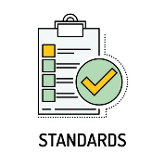
Standard
A standard is a repeatable, harmonised, agreed and documented way of doing something
Standards contain technical specifications or other precise criteria designed to be used consistently as a rule, guideline, or definition
As defined by ISO
“A standard is a document, established by a consensus of subject matter experts and approved by a recognized body that provides guidance on the design, use or performance of materials, products, processes, services, systems or persons”.

Slide 69

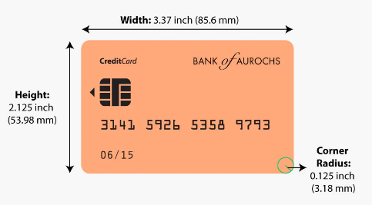
Standard - example
The size of payment cards (ATM cards, credit cards, debit cards, etc.) is 85.60 by 53.98 millimetres and rounded corners with a radius of 2.88–3.48 millimetres
conforming to the ISO/IEC 7810 ID-1 standard “Identification cards — Physical characteristics”

Slide 70
Standardization purpose
1. The standards ensure that goods or services produced in a specific industry come with consistent quality and are equivalent to other comparable products or services in the same industry
2. Standardization helps in ensuring the safety, interoperability, and compatibility of goods produced

Slide 71
Industry standardization examples
Parties | Mutual gains | Problem | Solution
Mechanical industry companies | Suppliers interchange, stock gains, etc. | Screw thread compatibility | Screw thread standard specifications
Pharmaceutical industry and medic community | Enable medical prescriptions, suppliers interchange, etc. | Drug uniformity | Drug standard specifications
Banks and specialized payment cards companies | Enable Credit card holder to pay a merchant for goods and services | Credit card uniformity | Credit card technical specifications

Slide 72
Who creates standards
Parties involved in the standardization processes:
Users
Interest groups
Corporations
Industrial or manufacturing associations
Professional societies
Governments
Standards organizations
…

Slide 73
Standards organization
A standards organization / standards body / standards developing organization (SDO) / standards setting organization (SSO)
An organization whose primary function is developing, coordinating, promulgating, revising, amending, reissuing, interpreting, or otherwise contributing to the usefulness of technical standards

Slide 74
International standard
An international standard is a technical standard developed by one or more international standards organizations
International standards are available for consideration and use worldwide

Slide 75
Role of international standards
International standards are essential for eliminating technical barriers to trade
They allow for services and products to be made available to others regardless of the country where they originated

Slide 76

International standard organizations
ISO - International Organization for Standardization
ITU - International Telecommunication Union
IEC - International Electrotechnical Commission
World Standards Cooperation alliance
Together, these three organizations have formed the World Standards Cooperation alliance

Slide 77
ISO: The International Organization for Standardization
An international standard development organization
It works in 167 countries
Develops and publishes standardization in all technical and nontechnical fields other than electrical and electronic engineering
Electronic engineering standards are responsibility of IEC - International Electrotechnical Commission

Slide 78

Example
This tea was made by a company that uses a quality management system specified in one of ISO standards
ISO9001:2015

Slide 79
ISO Standardization process
ISO has 804 technical committees and subcommittees concerned with standards development
International Standards are developed by ISO technical committees (TC) and subcommittees (SC) by a process with six steps
Stage 1: Proposal stage
Stage 2: Preparatory stage
Stage 3: Committee stage
Stage 4: Enquiry stage
Stage 5: Approval stage
Stage 6: Publication stage
As of April 2022, the ISO has developed over 24,261 standards, covering everything from manufactured products and technology to food safety, agriculture, and healthcare

Slide 80
Joint technical committee with IEC
ISO/IEC JTC 1
ISO has a joint technical committee (JTC) with the International Electrotechnical Commission (IEC) to develop standards relating to information technology

Slide 81
ISO/IEC JTC 1 Scope and mission
Develop, maintain, promote and facilitate IT standards required by global markets meeting business and user requirements concerning:
The design and development of IT systems and tools
The performance and quality of IT products and systems
The security of IT systems and information
The portability of application programs
The interoperability of IT products and systems
The unified tools and environments
The harmonized IT vocabulary
The user-friendly and ergonomically-designed user interfaces

Slide 82
ISO/IEC JTC 1 participation
Has 39 participating members
China is a participating member represented by SAC - the Standardization Administration of the P. R. C

Slide 83

Standardization Administration of the People's Republic of China (SAC), established in April 2001, is authorized by the State Council to undertake unified management, supervision and overall coordination of standardization work in China
SAC represents China to join
International Organization for Standardization (ISO)
International Electrotechnical Commission (IEC)
other international and regional standardization organizations.
SAC is also responsible for organizing the activities of Chinese National Committee for ISO and IEC
SAC approves and organizes the implementation of international cooperation and exchanging projects on standardization

Slide 84
ISO/IEC JTC 1 Structure
Most work on the development of standards is done by subcommittees (SCs), each of which deals with a particular field
Subcommittee dealing with the field of software and systems engineering is called ISO/IEC JTC 1/SC 7
Scope: standardization of processes, supporting tools and supporting technologies for the engineering of software products and systems
Most of these subcommittees have several working groups (WGs)

Slide 85
WG 42
Working group that carries out specific tasks in standards development within the field of architecture
Flagship standard:
ISO/IEC/IEEE 42010:2022 Software, systems and enterprise — Architecture description
Publication date : 2022-11
https://www.iso.org/standard/74393.html

Slide 86
Identification of stakeholders
An architecture description shall identify the stakeholders having concerns that are considered fundamental to the architecture of the software and consistent with the purpose of the architecture description.
An architecture description should identify the possible impacts of the architecture on the current and future stakeholders.
An architecture description shall include a statement of known resource limitations or other constraints that prevented the architecture description from addressing identified stakeholders and architecture considerations, i.e. concerns, perspectives, and aspects.

Slide 87
Identification of stakeholder perspectives
An architecture description shall identify stakeholder perspectives considered relevant to the architecture of the software and consistent with the purpose of the architecture description.
An architecture description shall associate each identified perspective with the identified stakeholders holding that perspective.
Within the scope of the intended purpose of the architecture description , the architecting effort should identify present or future stakeholder perspectives which may be relevant to the entity of interest.
For each identified perspective, an architecture description shall enumerate its resulting concerns from among identified concerns.
Stakeholder perspectives include: strategic, organizational, operational, logical, physical and technological perspectives.

Slide 88
Identification of concerns
An architecture description shall identify the concerns considered relevant to the architecture of the software and consistent with the purpose of the architecture description.
An architecture description shall associate each identified concern with the identified stakeholders holding that concern.
Concerns include the following: suitability of the architecture for achieving the objectives for the entity of interest, enterprise capability and capacity to implement the entity of interest, the feasibility of realizing and operating the entity of interest, the potential risks and impacts of the entity of interest to its stakeholders throughout its life cycle, added value to the stakeholder(s), reuse of known architectures, resilience, extensibility, adaptability, latency, resource utilization, effectiveness, operability, usefulness, usability, interoperability, complexity, sustainability and evolvability of the entity of interest, environmental impacts of the development, use, and disposal of the entity of interest.

Slide 89
Inclusion of architecture views
Each stakeholder perspective (mentioned before) identified by the architecture description shall be addressed by at least one view
Each concern identified by the architecture description shall be addressed by at least one view
… (please refer to the standard for more details if you are interested)

Slide 90
We will not study the details of the 4+1 model in class, but you can check the following PPT slides as well as the paper if you are interested.
4+1 View Model: Philippe Kruchten. 1995. The 4+1 View Model of Architecture. IEEE Softw. 12, 6 (November 1995), 42–50.

Slide 91
Which views to include?
Another answer to the question
Which structures should an architect work on? Which ones should the architect document?
Can be found in a very very influential paper published in 1995 by Philippe Kruchten
Philippe Kruchten. 1995. The 4+1 View Model of Architecture. IEEE Softw. 12, 6 (November 1995), 42–50.
He described the concept of architecture comprising separate structures and advised concentrating on four. To validate that the structures were not in conflict with each other and together did in fact describe a system meeting its requirements, Kruchten advised using key use cases as a check
This so-called "Four Plus One" approach became popular and has now been institutionalized as the conceptual basis of the Rational Unified Process.

Slide 92
Overview about the article's author:
Philippe Kruchten has extensive of experience as a leader of the development team in Rational corporation.
He had a good experiences in industry (Telecom, Air traffic control system) which he used to justify his model.
“4+1 views” methodology successfully used in the industry
Air Traffic Control
Telecom

Slide 93
Problems:
Architecture documents do not address the concerns of all stakeholders.
Different Stakeholders : end-user, system engineers, developers and project managers.
Architecture documents contained complex diagrams some times they are hard to be represented on the documentation.

Slide 94
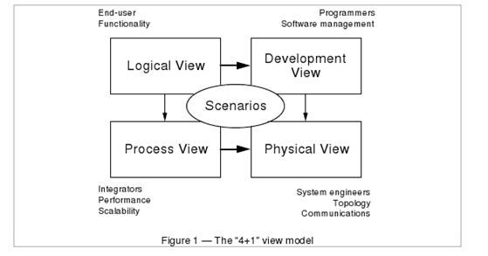
Solution
4+1 View Model of Architecture
Using different notations for several Views each one addressing one specific set for concerns.
Use“4+1” view model.
Philippe Kruchten
Rational Software Corp.

Slide 95
Logical View
The logical view, which is the object model of the design (when an object-oriented design method is used)
Viewer: End-user
considers: Functional requirements- What are the services must be provided by the system to the users.
Notation: The Booch notation.
Tool: Rational Rose

Slide 96
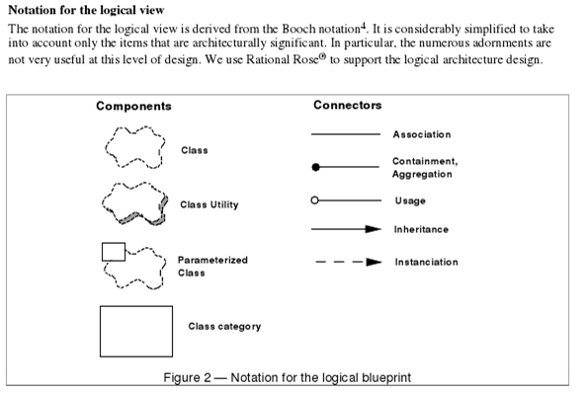
By Philippe Kruchten
Rational Software Corp.

Slide 97
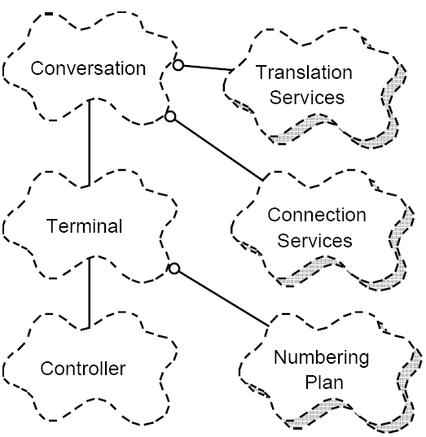
Logical view Example
Philippe Kruchten
Rational Software Corp.

Slide 98
Process View
The process view, which captures the concurrency and synchronization aspects of the design(The process decomposition).
viewer: Integrators
considers: Non - functional requirements (scalability, concurrency, and performance)
style: Garlan and Shaw ‘s Architecture styles.
Uses multiple levels of abstractions.
A process is a grouping of tasks that form an executable unit:
Major Tasks: Architecture relevant tasks.
Minor or helper Tasks: (Buffering)

Slide 99
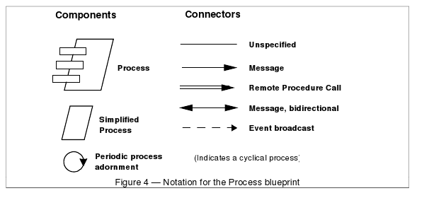
Notation
By Philippe Kruchten
Rational Software Corp.

Slide 100
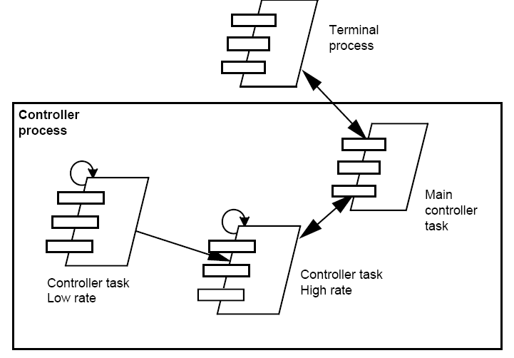
Process View example
Philippe Kruchten
Rational Software Corp.

Slide 101
Development View
The development view, which describes the static organization of the software in its development environment.
Viewer: Programmers and Software Managers
considers: software module organization. (Hierarchy of layers, software management, reuse, constraints of tools).
Notation: the Booch notation.
Style: layered style

Slide 102
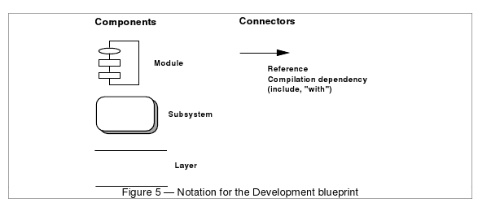
Notation
By Philippe Kruchten
Rational Software Corp.

Slide 103
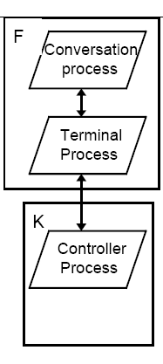
Physical View
the physical view, which describes the mapping(s) of the software onto the hardware and reflects its distributed aspect.
Viewer: System Engineers
Considers: Non-functional requirement (reliability, availability and performance). regarding to underlying hardware.
There may be two architecture:
Test and development
deployment
By Philippe Kruchten
Rational Software Corp.

Slide 104
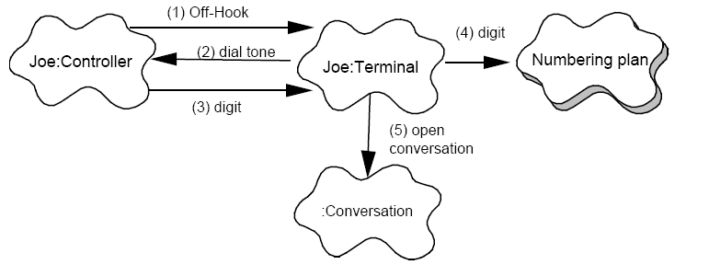
Scenarios
(Putting all “4 views” together)
Viewer:
All users and Evaluators.
Considers:
System consistency and validity
Notation:
Similar to logical view
By Philippe Kruchten
Rational Software Corp.

Slide 105
Correspondence between the views
The views are interconnected.
Start with Logical view and Move to Development / Process view and then finally go to Physical view.
From logical to Process view
Two strategies:
Inside-out: starting from Logical structure
Outside-in: starting from physical structure
From Logical to development
They are very close, but the larger the project, the greater the distance between these views.
Grouping to subsystems depending on:
The team organization.
The class categories which includes the packages.
The Line of codes.

Slide 106
Iterative process
Not all architectures need all views.
A scenario-driven approach to develop the system is used to handle the iterative.
Documenting the architecture:
Software architecture document: follows closely “4+1” views.
Software design guidelines: it captured the most important design decisions that must be respected to maintain the architectural integrity.

Slide 107
End of 4+1 View Model
Philippe Kruchten. 1995. The 4+1 View Model of Architecture. IEEE Softw. 12, 6 (November 1995), 42–50.

Slide 108
C4 model
A lean graphical notation technique for modelling the architecture of software systems.
It is based on a structural decomposition of a system into containers and components.
The C4 model was created by the software architect Simon Brown between 2006 and 2011 on the roots of Unified Modelling Language (UML) and the 4+1 architectural view model
The C4 model documents the architecture of a software system, by showing multiple points of view that explain the decomposition of a system into containers and components, the relationship between these elements, and, where appropriate, the relation with its users.
The viewpoints are organized according to their hierarchical level:
Context diagrams (level 1)
Container diagrams (level 2)
Component diagrams (level 3)
Code diagrams (level 4)

Slide 109
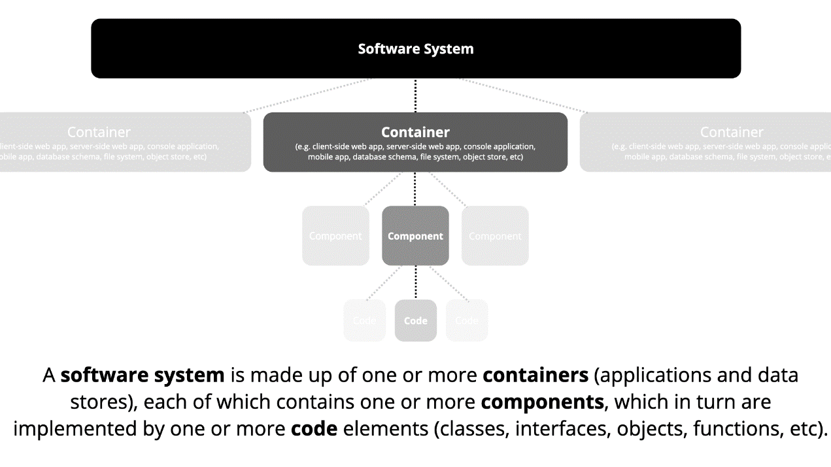

Slide 110
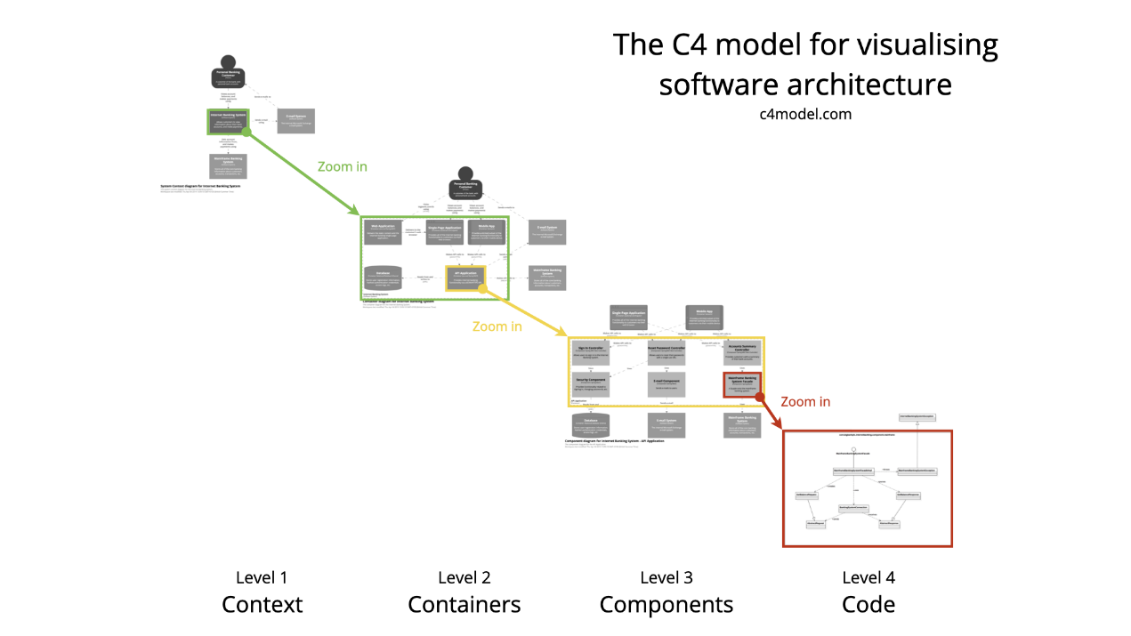

Slide 111
C4 model - Context diagrams (level 1)
Show the system in scope and its relationship with users and other systems

Slide 112
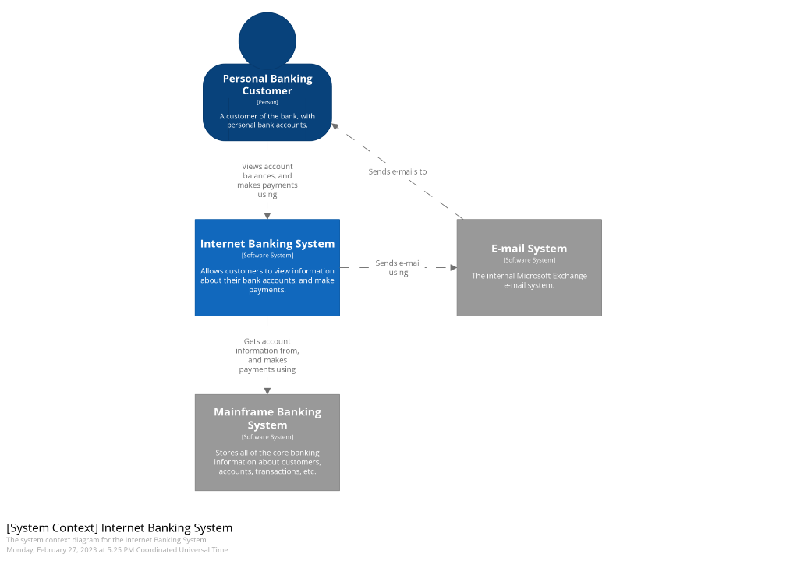

Slide 113
C4 model - Container diagrams (level 2)
Decompose a system into interrelated containers. A container represents an application or a data store

Slide 114
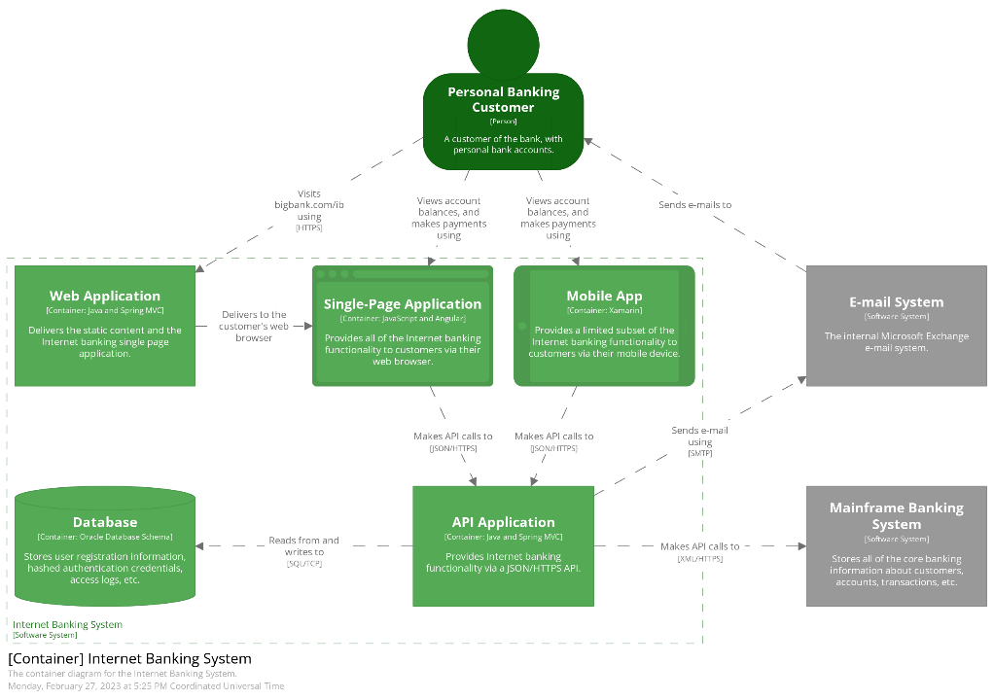

Slide 115
C4 model - Component diagrams (level 3):
Decompose containers into interrelated components, and relate the components to other containers or other systems

Slide 116
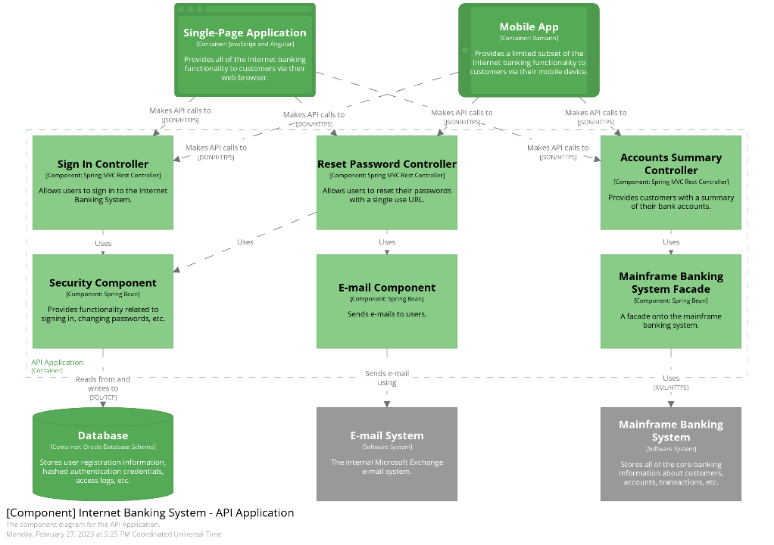

Slide 117
C4 model - Code diagrams (level 4)
Provide additional details about the design of the architectural elements that can be mapped to code.

Slide 118
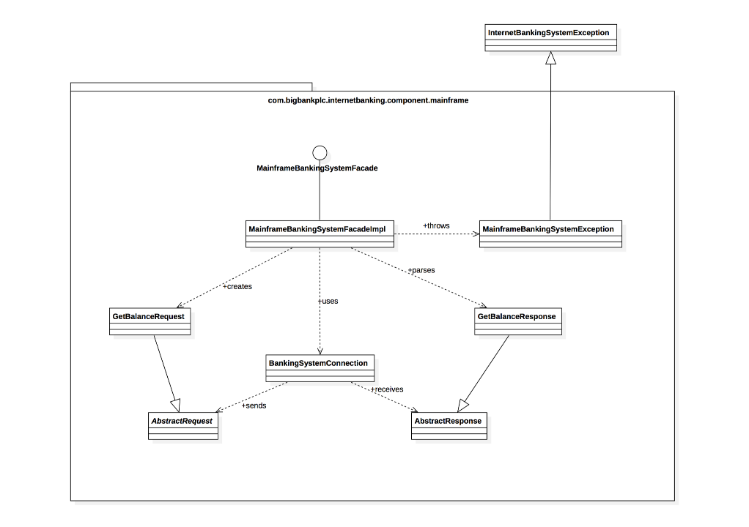

Slide 119
Example of documenting in C4 model: level 1 – context diagrams
You are building a web application that digital artists can use to manage and send invoices to clients.
At a minimum, your diagram should include the:
Database
Business logic component
UI
What would a context diagram for this system look like?

Slide 120
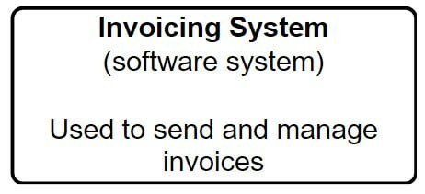
Example of documenting in C4 model: level 1 – context diagrams
First, start with a representation of your software system.

Slide 121
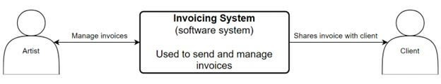
Example of documenting in C4 model: level 1 – context diagrams
Next, you want to document who the actors are. Actors are anyone who will be using the software system.
In this example, our actors are:
Digital artists
Clients

Slide 122
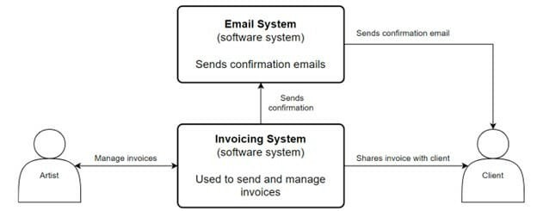
Example of documenting in C4 model: level 1 – context diagrams
Now that you know who your actors are, document any external systems interacting with the software system.

Slide 123
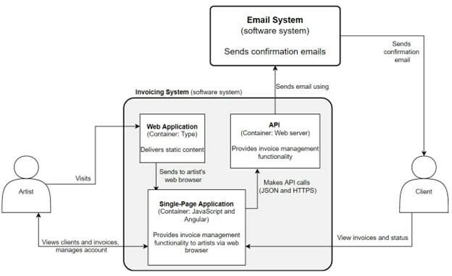
Example of documenting in C4 model: level 2 – container diagrams
If you wanted to go a level deeper, you could create a container diagram.
A container diagram would focus on the applications that make up a specific container.

Slide 124
End of C4 model
If you are interested, you can find more details here
https://c4model.com/

Slide 125
Building the Documentation Package
Documentation package consists of
Views
Documentation beyond views

Slide 126
Documenting Behavior
Behavior documentation complements each views by describing how architecture elements in that view interact with each other.
Behavior documentation enables reasoning about
a system’s potential to deadlock
a system’s ability to complete a task in the desired amount of time
maximum memory consumption
and more
Behavior has its own section in our view template’s element catalog.

Slide 127
View Template

Slide 128
Notations for Documenting Behavior
Trace-oriented languages
Traces are sequences of activities or interactions that describe the system’s response to a specific stimulus when the system is in a specific state.
A trace describes a particular sequence of activities or interactions between structural elements of the system.
Examples
use cases
sequence diagrams
communication diagrams
activity diagrams
message sequence charts
timing diagrams
Business Process Execution Language

Slide 129
Use Case Diagram
From Documenting Software Architectures: Views and Beyond, 2nd edition, Addison Wesley, 2010

Slide 130
Use Case Description
From Documenting Software Architectures: Views and Beyond, 2nd edition, Addison Wesley, 2010

Slide 131
Sequence Diagram

Slide 132
Communication Diagram
From Documenting Software Architectures: Views and Beyond, 2nd edition, Addison Wesley, 2010

Slide 133
Activity Diagram
From Documenting Software Architectures: Views and Beyond, 2nd edition, Addison Wesley, 2010

Slide 134
Summary
The software architecture of a system is the set of structures needed to reason about the system, which comprise software elements, relations among them, and properties of both.
A structure is a set of elements and the relations among them.
A view is a representation of a coherent set of architectural elements. A view is a representation of one or more structures.
You must choose the views to document, must choose the notation to document these views, and must choose a set of views that is both minimal and adequate.
You must document not only the structure of the architecture but also the behavior.

